Slide 1

Capstone Project 5 LIVE CLASS MONITORING SYSTEM (FACE EMOTION RECOGNISATION)
BY SANDEEP KR SINGH

Slide 2
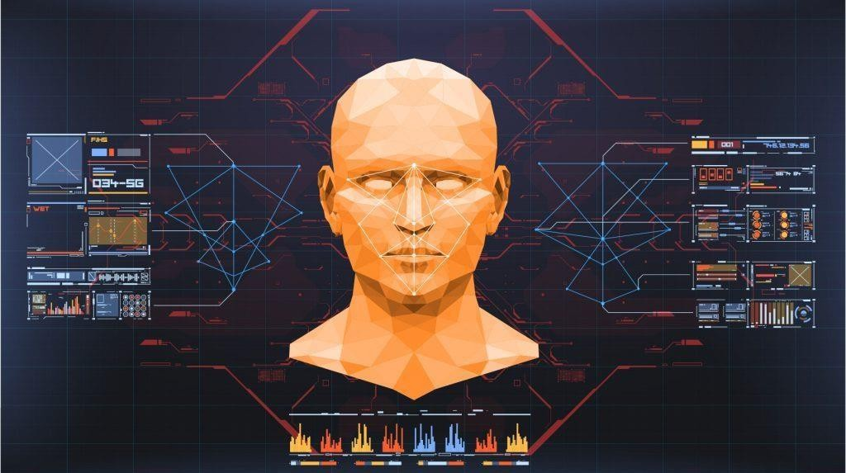
CONTENT
Introduction
Problem Statemen
Data Summary
Dependencies
Modelling Overvie
Deployment
Prediction
Challenges
Conclusion
t
w

Slide 3
INTRODUCTION
Face Emotion Recognisation is
Process of Identifying Human Emotion.
Facial expressions are a form of nonverbal communication.
There is strong evidence for the universal
facial expressions of seven emotions which
include: neutral happy, sadness, anger, disgust, fear, and surprise.
It is very important to detect these emotions on the face as it has wide applications in the field of Computer Vision and Artificial Intelligence.

Slide 4
PROBLEM STATEMENT
Global Education System undergoes rapid changes over last 10 years
owing to the advancement of web based learning services, specifically,
eLearning platforms. Global E-learning is grown upto 8 times India is
expected to grow with a CAGR of 44% crossing the 10M users mark in 2021.
Despite market growth there are few challenges associated with digitallearning
when compared to conventional classroom based learning
Adaptive Teaching: Digital learning provides good quality content but less
adaptive for teacher. In a physical classroom teacher can see the faces and assess the emotion of the class and tune their lecture accordingly
In Digital classrooms it’s not possible for medium scale class (25-50) to see
all students and access the mood. students are not focusing on content due to lack of surveillance.
But with the power of AI and Computer Vision and Deep learning backed
system not only solves the surveillance issue, but it also removes the
human bias from the system, and all information is no longer in the
teacher’s brain rather translated in numbers that can be analyzed and tracked.
The proposed solution to this problem is by recognizing facial emotions.

Slide 5
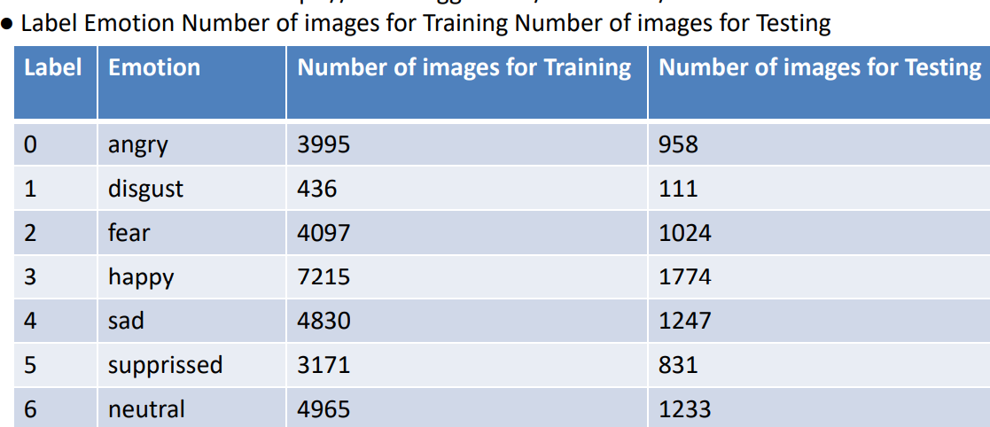
DATA SUMMARY
* I have built a deep learning model which detects the real time emotions of students through a webcam so that teachers can understand if students are able to grasp the topic according to students' expressions or emotions and then deploy the model. The model is trained on the FER-2013 dataset . This dataset consists of 35887 grayscale, 48x48 sized face images with seven emotions - angry, disgusted, fearful, happy, neutral, sad and surprised.

Slide 6
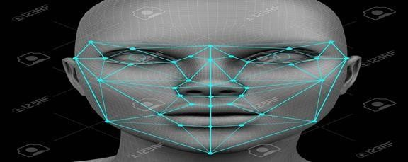
Face embeddings
By creating face embeddings you are converting a face image into numerical data. That data is then represented as a vector in a latent semantic space. The closer the embeddings are to each other in the latent space, the more likely they are of the same person.

Slide 7
DEPENDENCIES
1. Python 3 2.Tensorflow 2.0 3.Streamlit 4.Streamlit- Webrtc 5.OpenCV

Slide 8
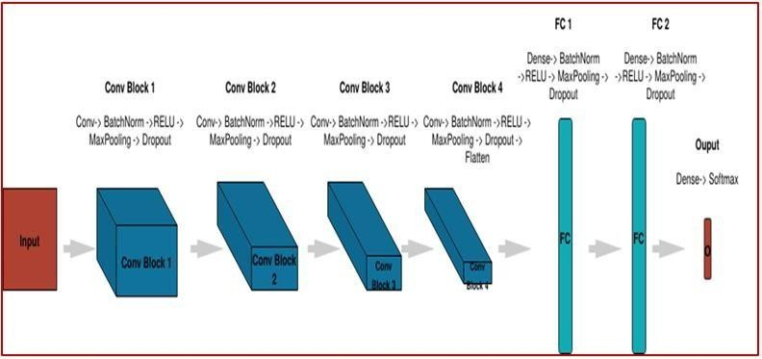
Model Building

Slide 9
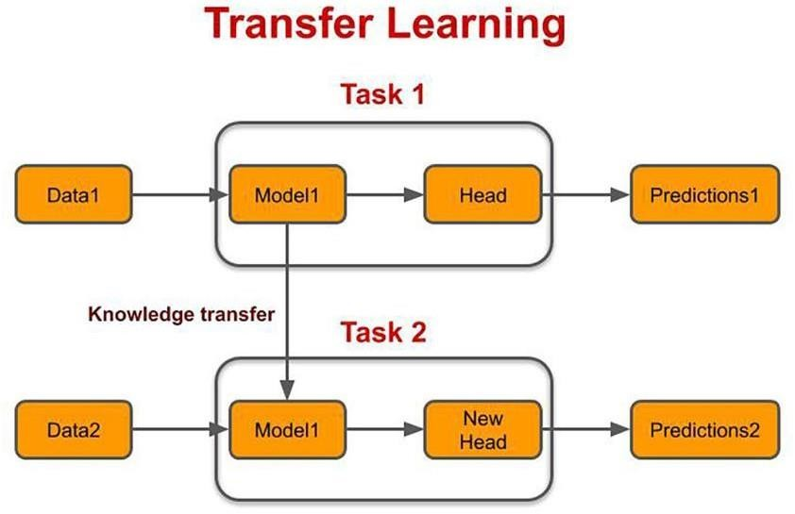
Transfer learning : MobileNetV2-removing last layer + some additional dense layer + adding Final Layer Contains seven output equivalent to number of classes i.e angry, disgust, fear, happy, neutral, sad, and surprise
Face Detection : Haar Cascascade Classifier
Building web app via streamlit
webcam feed image in model via streamlit-webrtc

Slide 10
DEPLOYMENT
Different type of Deployment Platform such as Azure, Heruko, Streamlit-Sharing, AWS etc.
https://share.streamlit.io/sandeep0097-97/face-emotion-recoginition/main

Slide 11
Prediction
Finally I build the WebApp using streamlit and deployed in Streamlit-Sharing.
The model which was created by CNN layers gave training accuracy of 95%

Slide 12
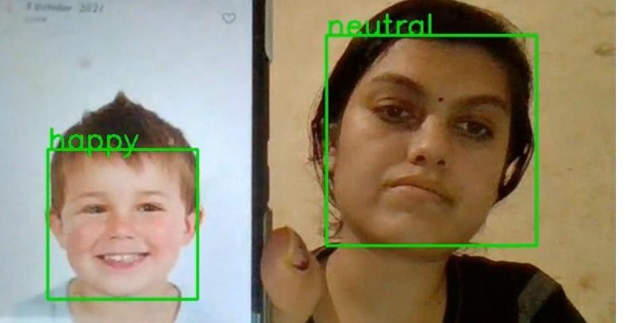
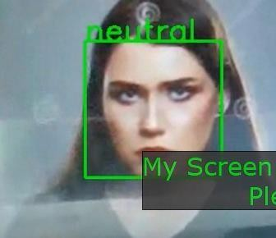
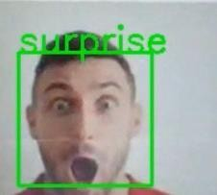
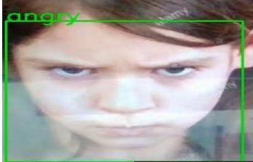
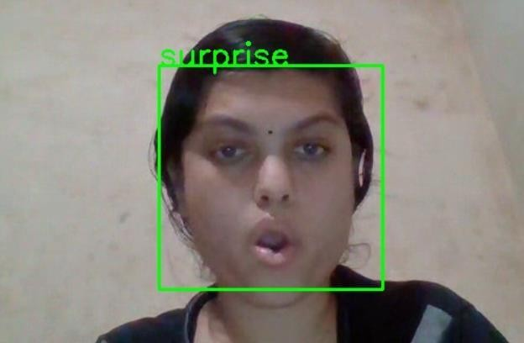
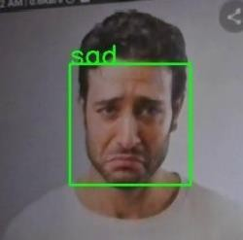
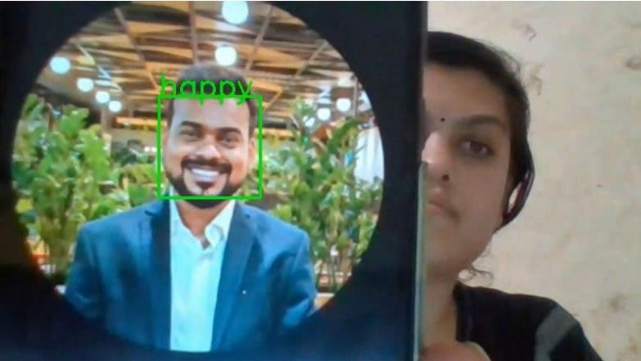
Prediction

Slide 13
CONCLUSION
Finally I build the WebApp using streamlit and deployed in streamlit sharing.
The model which was created by CNN layers gave accuracy of 87%. I have used streamlit- webrtc which helped to deal with real-time video streams. Image captured from the webcam is sent to VideoTransformer function to detect the emotion.

Slide 14
Challenges Faced
Choosing the dataset was difficult without Kaggle it saved most of the time.
Couldn’t able to connect GPU with Jupyter Notebook.
Continuous Runtime and RAMCrash due to large dataset.
GCP, AWS and Azure could platforms were not able to deploy due to credit card details requirement, instead I did it in streamlit-sharing.

Slide 15


















